Slide 1
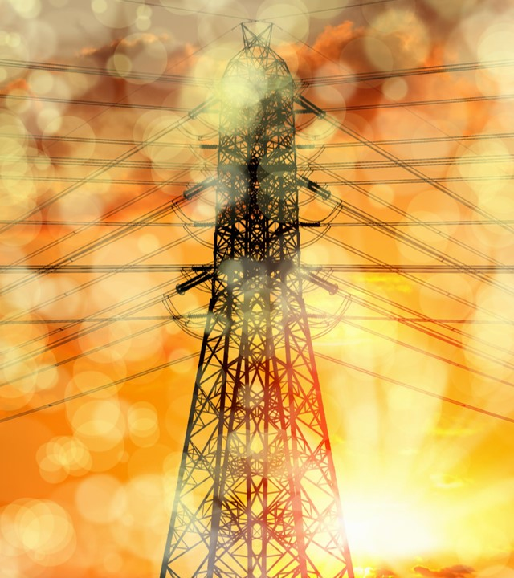

Tabletop Distribution Grid & Automation Trainer
Innovative hands-on learning for modern power systems

Slide 2
About Me
Zach Wadley, P.E. - Electric System Engineer
Union University class of 2015 graduate (B.S.E. with concentration in electrical)
Participated in a one-year cooperative learning experience with JEA between my Junior and Senior years
7 plus years of experience in cooperative electric distribution design
3 plus years of experience in municipal distribution and transmission design
Obtained P.E. license (Power Discipline) in 2018
Oversees all engineering for the electric and telecom systems

Slide 3
About Jackson Energy Authority
JEA was incorporated in 1936
JEA is a multi-service utility providing electric, natural gas, propane, water, wastewater and broadband service to over 35,000 customers
JEA was the first utility in the state of TN to deliver a full fiber to the home network
JEA has been recognized nationally by both the APPA and APGA for reliability and performance awards
The electric division operates over 700 miles of distribution and transmission lines across Madison County
The electric division is responsible for the operation and maintenance of 53 power transformers across 29 substation locations
The electric division maintains ~ $300m in plant (prior to depreciation)

Slide 4
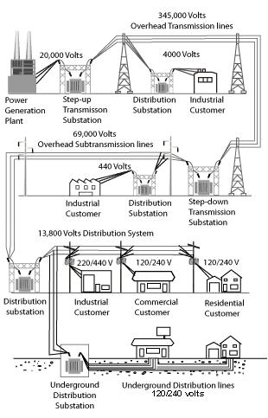
Power Distribution Diagram

Slide 5
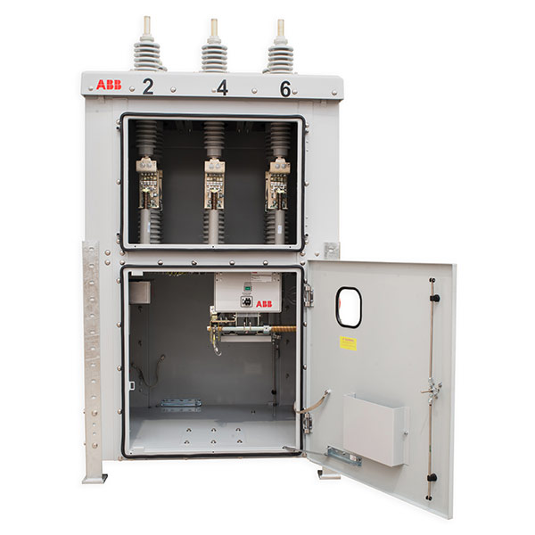
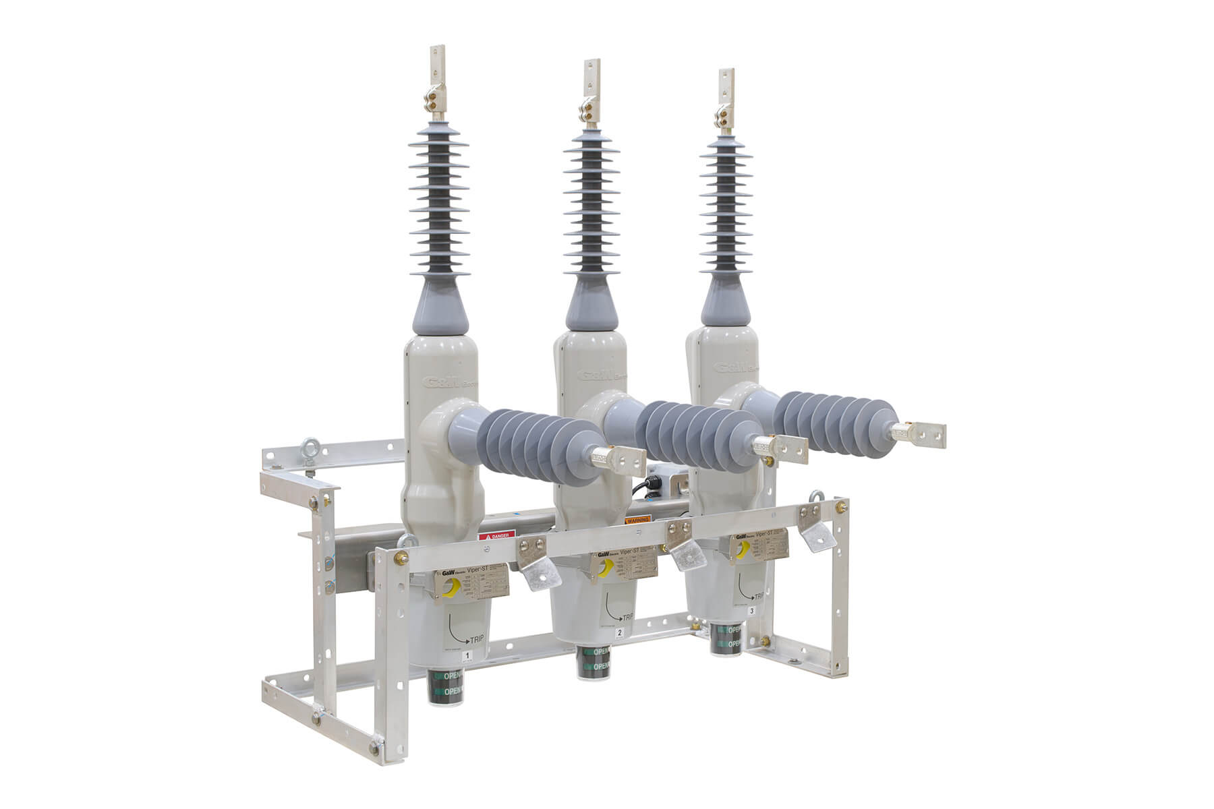
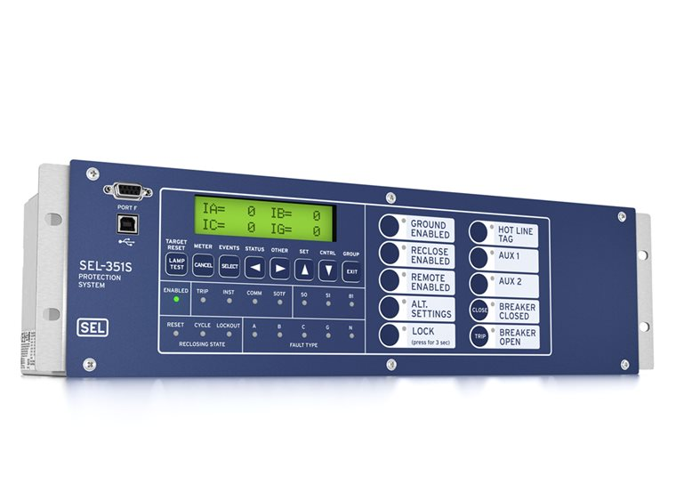
Power System Components
SEL 351S Relay
Viper ST Recloser
RMAG 15kV Circuit Breaker

Slide 6
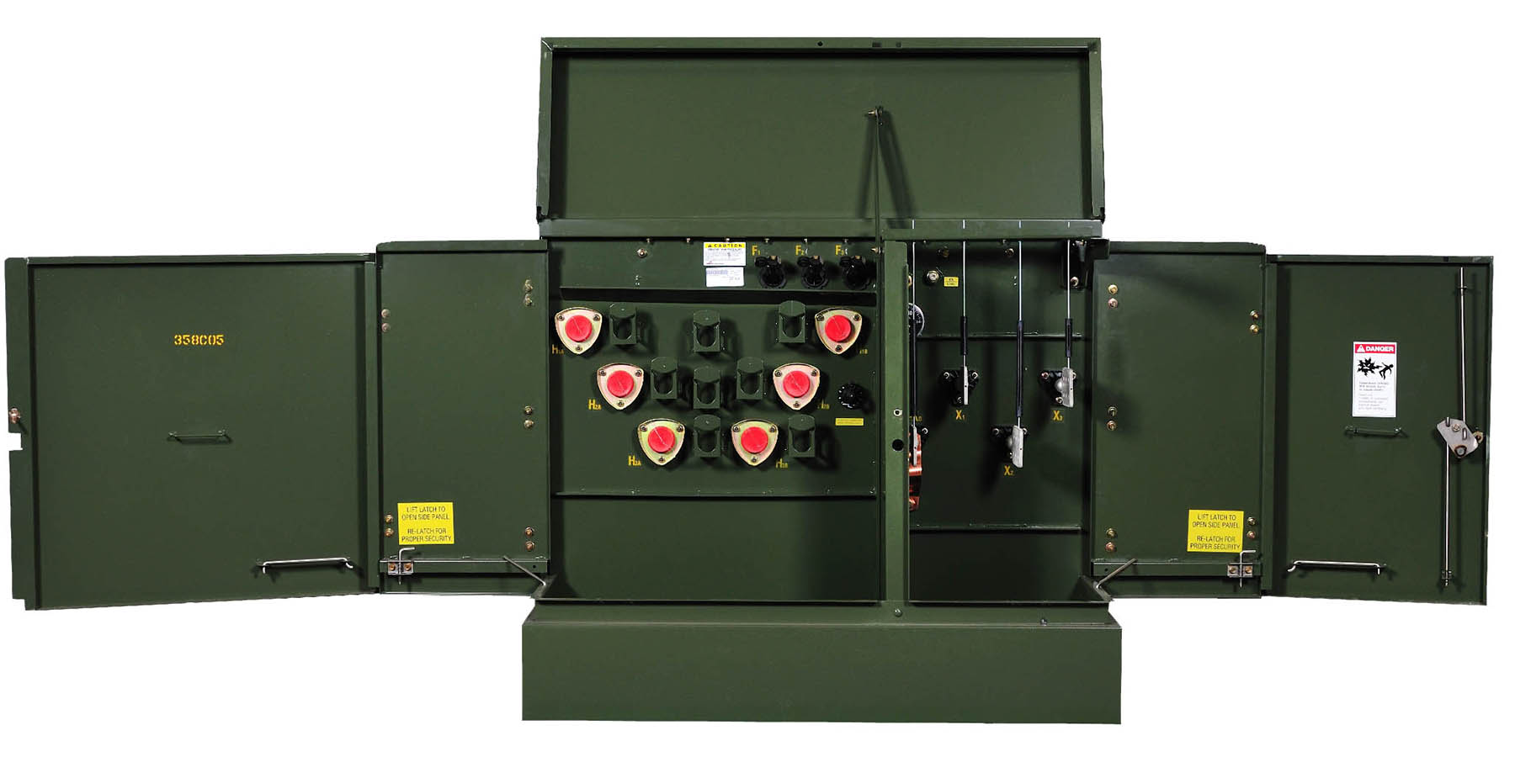
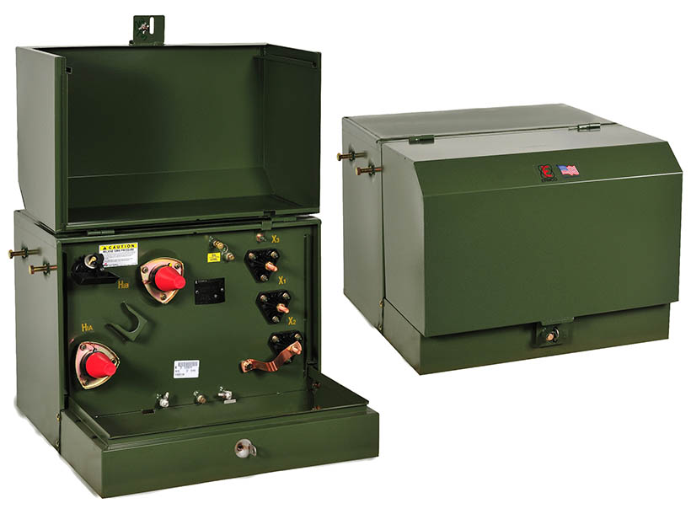
Power System Components
Three Phase Padmounted Transformer
240/120V Single Phase Padmounted Transformer

Slide 7
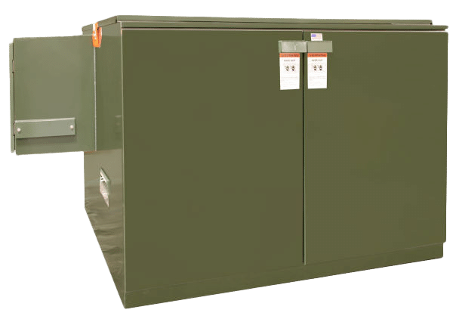
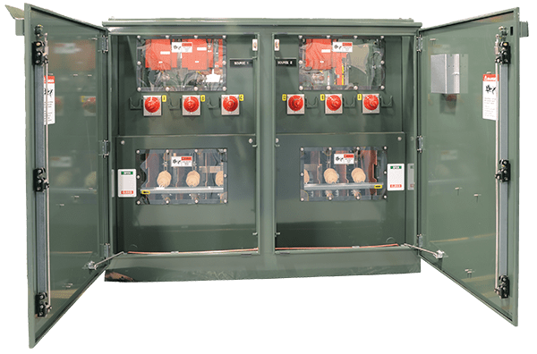
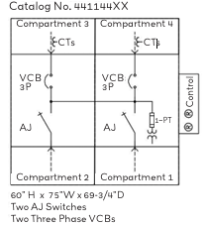
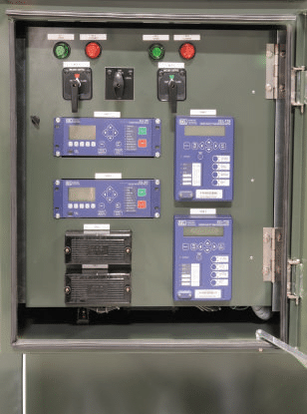
Power System Components
Padmounted Switchgear

Slide 8
Project Proposal Overview
Realistic Engineering Challenge
Students will build a scaled model of an underground distribution system mirroring real-world components and utility operations within an academic setting.
Integration of Technologies
Students will integrate power systems, sensing, communications, control logic and human-machine interfaces for comprehensive learning.
Focus on System Restoration
Students will simulate system faults to demonstrate distribution automation and FLISR concepts (Fault Location, Isolation and Service Restoration).
Industry Applicable
Sponsored by a utility implementing these concepts today.

Slide 9
Purpose and Objectives of the Tabletop Trainer
Core Project Objective
Design and build a tabletop distribution automation system that mimics real electrical feeder operations for fault management.
Utility-Style Control Logic
Implement operational logic, switching sequences, and verification steps based on actual utility practices and SCADA concepts using an SEL RTAC.
System-Level Engineering Focus
Focus on system behavior with states, operator feedback and system measurements.

Slide 10
What the students will design and build
Radial Feeder Topology
The project will involve designing and building a radial feeder with two power sources and a normally open tie switch configuration.
DER Integration
Interconnect a DER system to the grid to introduce bi-directional power flow and demonstrate the importance of IEEE 1547 standards.
Operational Training
Tabletop trainer will be used to teach young engineers and lineman basic distribution automation concepts.

Slide 11
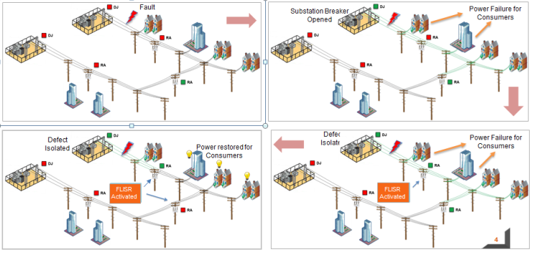
FLISR Explained

Slide 12
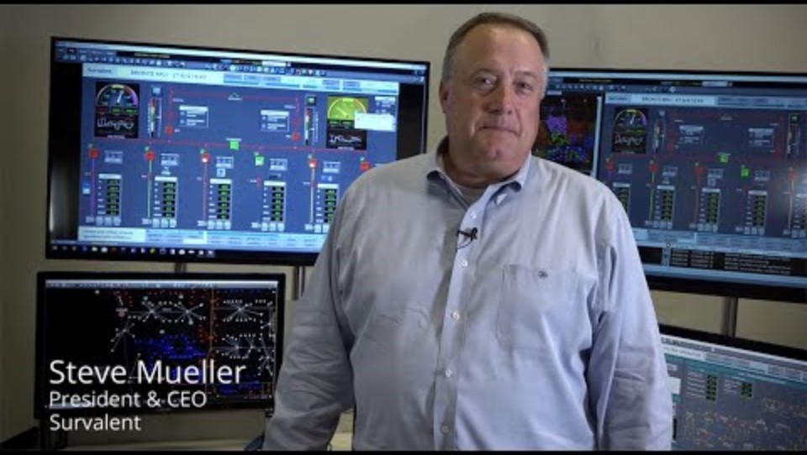
FLISR Explained

Slide 13
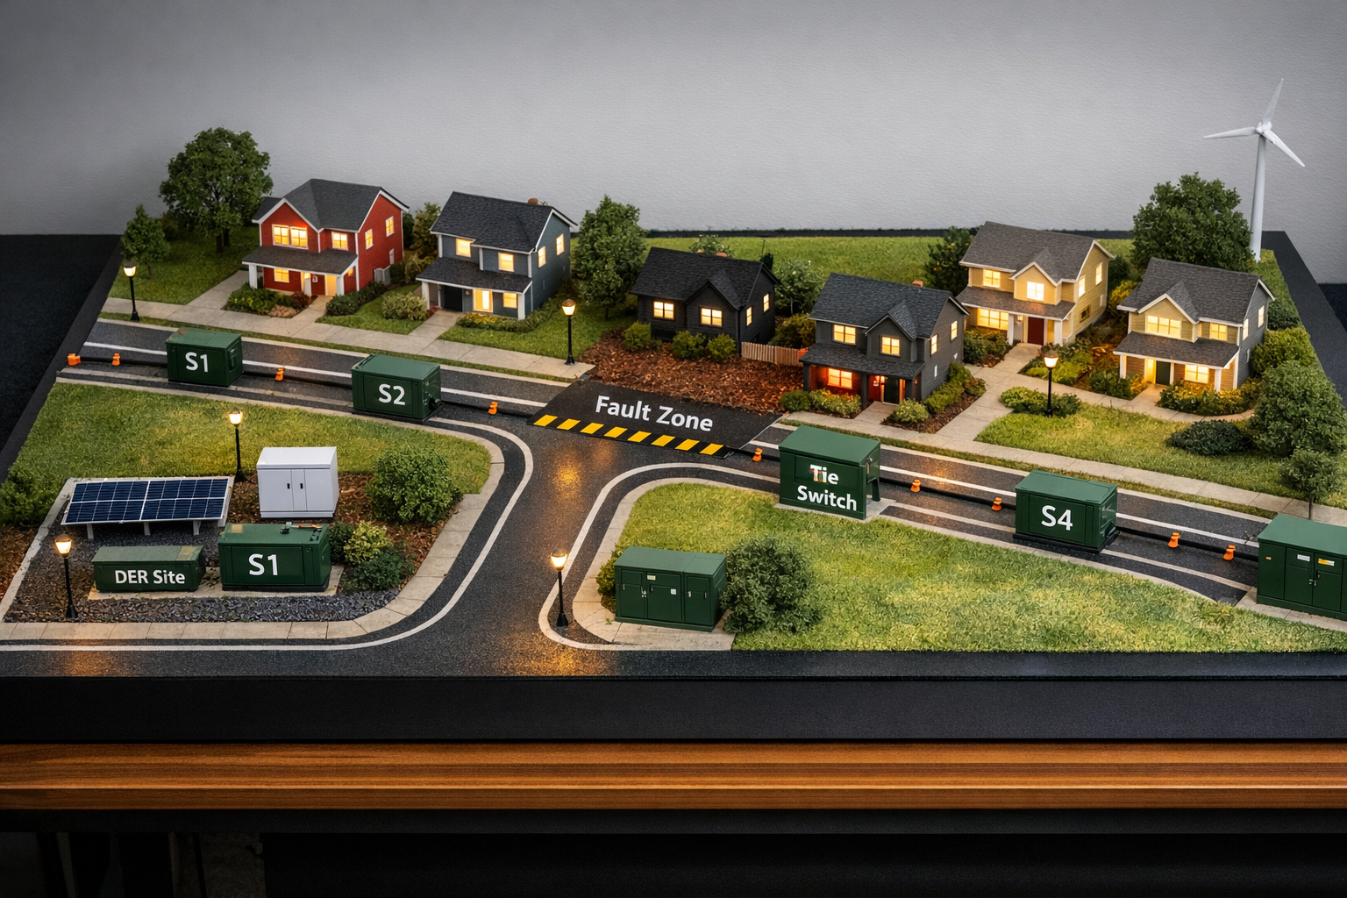
Physical Project Deliverables
Portable tabletop display
3D printed power system components
Fully functional power system grid
Status indicators for each device
Variable resistive loads
Strategic installation of voltage and current sensors
DER interconnection
Programmable Logic Controller capable of implementing FLISR
Real-time HMI
Ai Generated Concept Picture

Slide 14
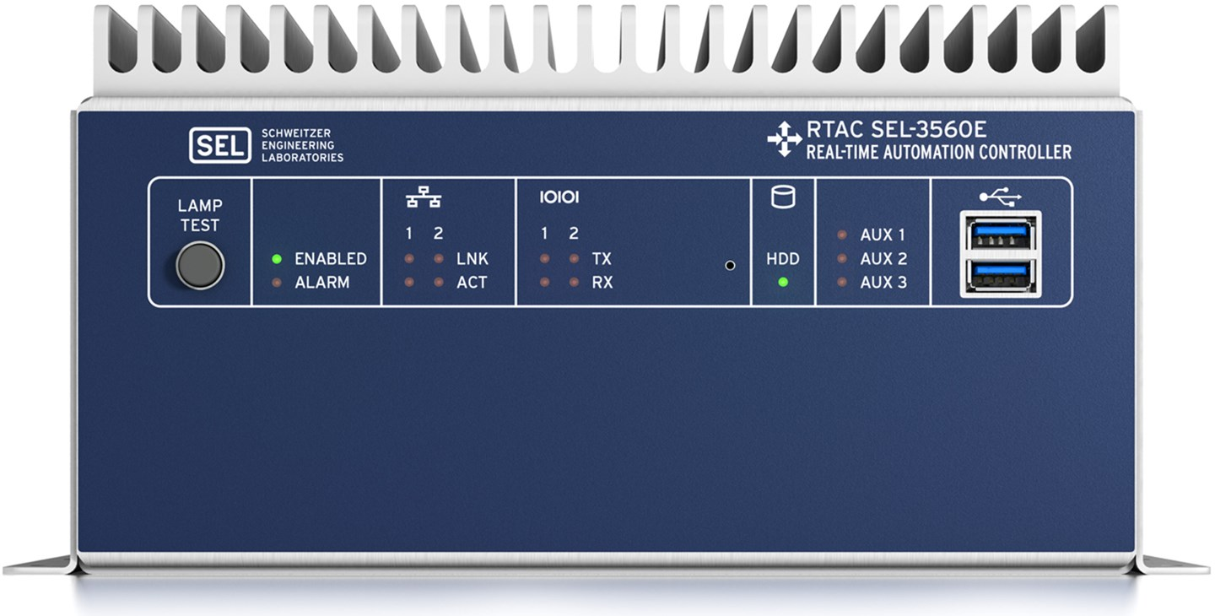
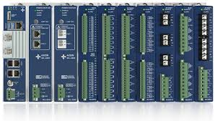
Physical Project Deliverables
Portable tabletop display
3D printed power system components
Fully functional power system grid
Status indicators for each device
Variable resistive loads
Strategic installation of voltage and current sensors
DER interconnection
Programmable Logic Controller capable of implementing FLISR
Real-time HMI
SEL RTAC (Real Time Automation Controller)

Slide 15
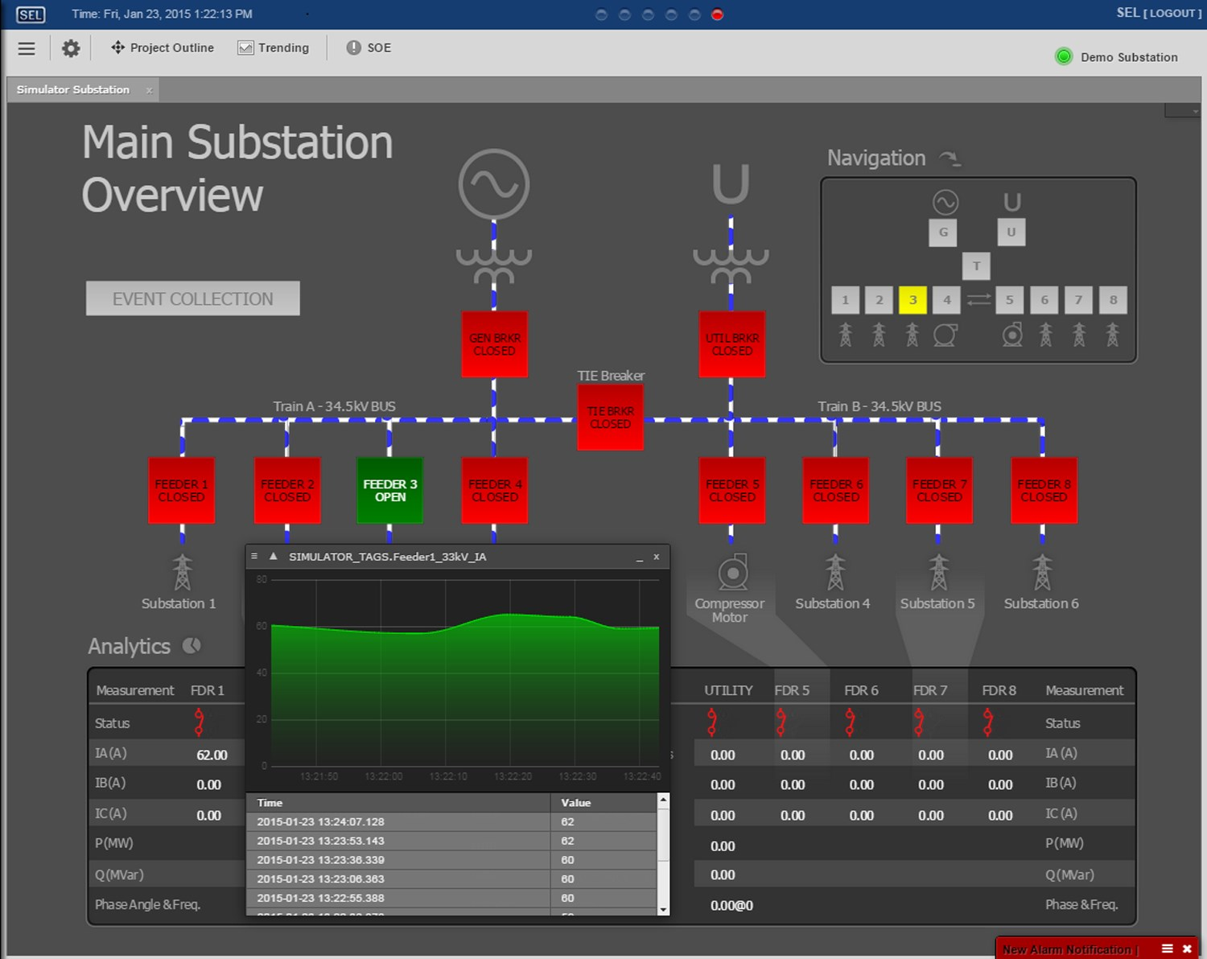
Physical Project Deliverables
Portable tabletop display
3D printed power system components
Fully functional power system grid
Status indicators for each device
Variable resistive loads
Strategic installation of voltage and current sensors
DER interconnection
Programmable Logic Controller capable of implementing FLISR
Real-time HMI
SEL RTAC Generated HMI Screen

Slide 16
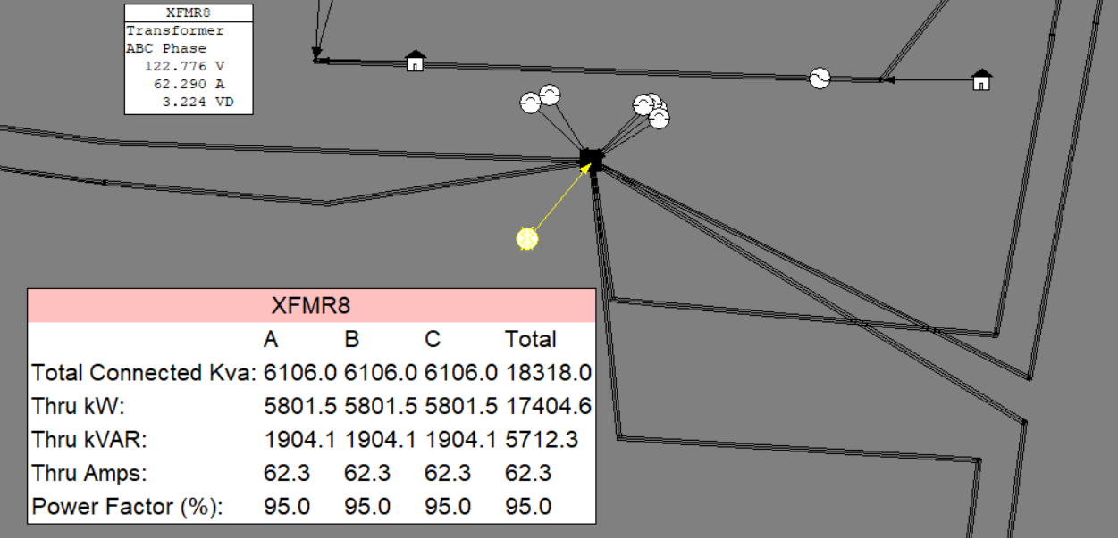

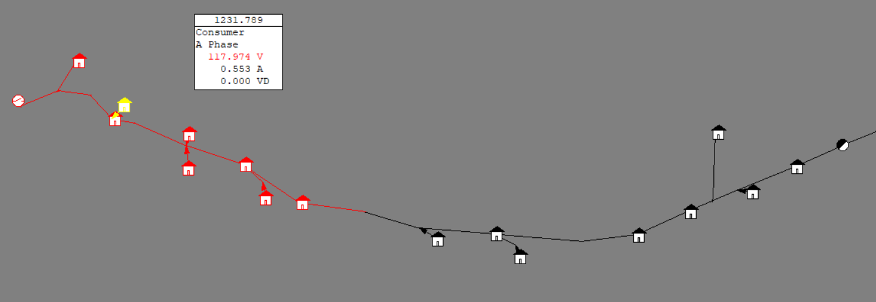
Technical Project Deliverables
Scaled digital model in Milsoft’s EA software to analyze power flow
Proposed System Coordination Study in Milsoft’s LightTable Solution to verify device coordination
Implementation of the relevant ANSI, IEEE and NESC standards
Example distribution analysis

Slide 17
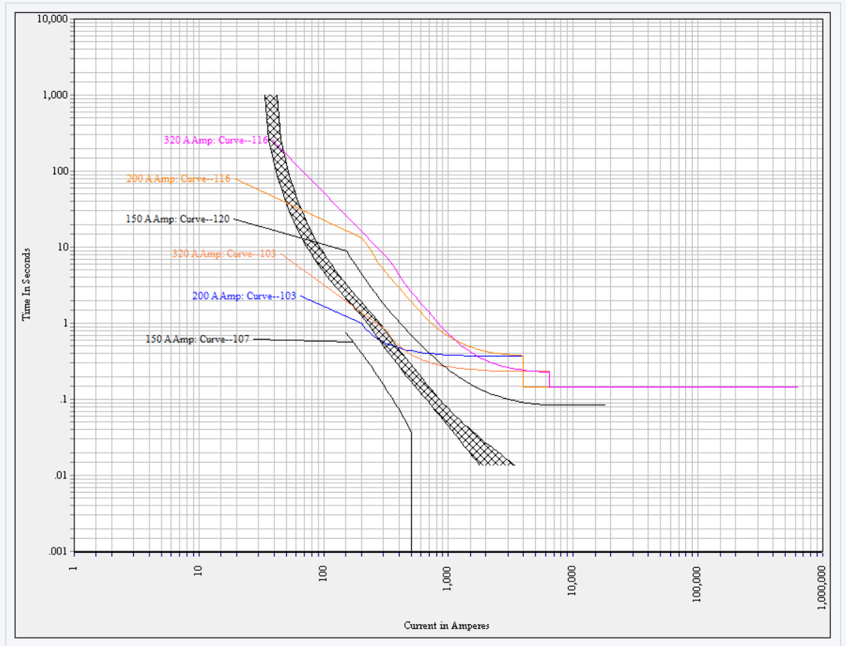
Technical Project Deliverables
Scaled digital model in Milsoft’s EA software to analyze power flow capabilities
Proposed System Coordination Study in Milsoft’s LightTable Solution to verify device coordination
Implementation of the relevant ANSI, IEEE and NESC standards
Example TCC (Time Current Curve) coordination

Slide 18
Long-Term Impact
Real-World Power Systems Experience
  Implementing modern distribution system concepts
  Exposure to RTAC/SCADA-style control
  This experience mirrors what utilities and consumers face daily
Multidisciplinary Engineering Skillset
  Power Systems, Controls, Communications, Hardware Design
Bridges Theory and Real-World Grid Operation
  From System modeling in Milsoft to physical system behavior
Resume-Level Project
  Highly relevant to utilities, EPCs and grid modernization roles
Workforce Development
  Train the workforce of the future

Slide 19
Questions?
Zach Wadley, P.E. - Electric System Engineer
Email: zwadley@jaxenergy.com
Cell: 731.499.0906

